Slide 1


Environmental Accommodations
Physical Environment
Adjustable seats
Standing desk
Replace fluorescent lights with LED lights
Provide desk dividers/sound absorption panels around the workspace
Provide quiet spaces
Try to minimize sudden/loud/high pitched noises (forewarn of fire drills)

Slide 2
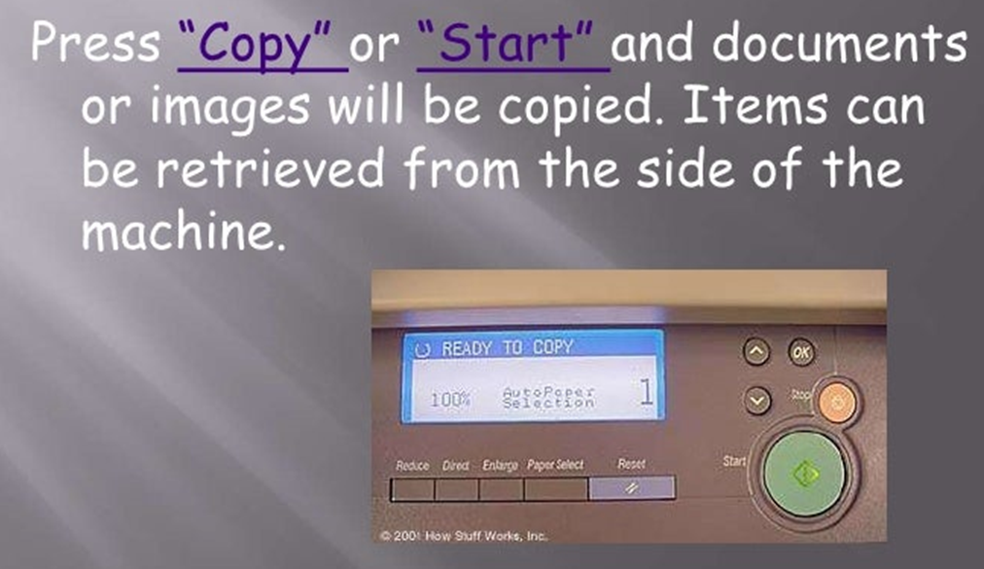
Environmental Accommodations
Access to company Occupational Therapist
Allow them to eat alone at their desk if desired
Regular updates on what’s happening in the organisation via email or social media
Social Stories where appropriate
Staff bios (pictures/titles and job roles)
360 video of the environment to offer predictability
Visual for everything

Slide 3
Autism Strengths - Recap
Detail Orientated
Highly focused
Diligent
Reliable
Honest
Loyal
Expert knowledge
Strong memory
Different perspective
Innovative problem solving
Notes:
Recap on the strengths

Slide 4
Employee Accommodations
Provide a visual schedule of their week/day
Organise large tasks into several smaller tasks
Provide reminders of when to move to the next task
Provide a to-do list of assignments for each day
Colour-code tasks by priority
Provide written/visual reminders of job tasks, particularly important tasks
Allow the individual to choose their preferred communication style – verbal, email, voice note or message
Provide advanced notice when meetings happen and what topics will be discussed

Slide 5
Employee Accommodations
Assign Autism Friendly Champion as their mentor and where possible this should be the only person to assign work/provide guidance
Where possible let them set their own working hours or provide set working hours which will only change if at least one week’s notice given
Provide opportunity for part-time positions to reduce risk of ‘burn-out’
If appropriate, allow them to work hybrid style
Provide new information via their preferred learning style

Slide 6
Employee Accommodations
When communicating:
Pauses to allow processing time
Use literal language
Provide opportunity for clarification/questions
Provide access to a recording software where appropriate
Provide written lists of crucial information such as passwords
Provide specific feedback to help employee target areas of improvement
Set clear expectations around performance standards
Let them know of any unwritten social rules/expectations
Plenty of notice for change and transition

Slide 7
Employee Disclosure
Application and induction process should both include a Neuroinclusivity policy
Disclosure process should be outlined with variety of ways to disclose
Reasonable accommodations offered should be made known
Links to external supports provided

